Slide 1
CASE STUDY Digital Marketing Associate in a Educational Company
Presented By
Krishna
Sujit
Vijay
Raghu
Pushyami
Goutam

Slide 2
Solutions Derived
Identify the marketing source giving you the best result?
Which product you should focus more?
Your strategy for work force?
Your strategy Call Centre

Slide 3
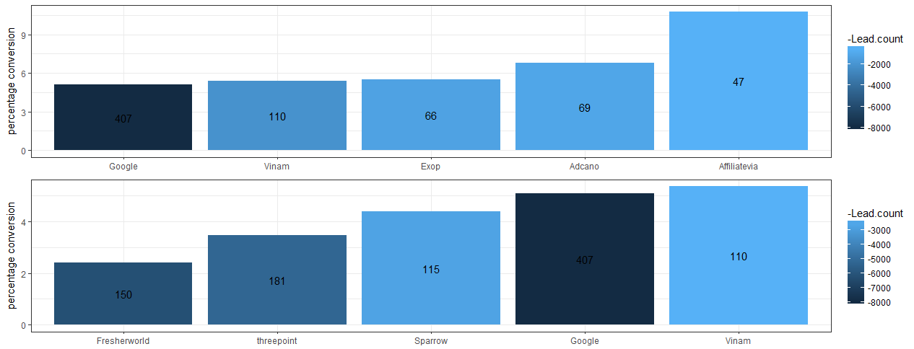
Case 1:
Identify the marketing source giving you the best result?

Slide 4
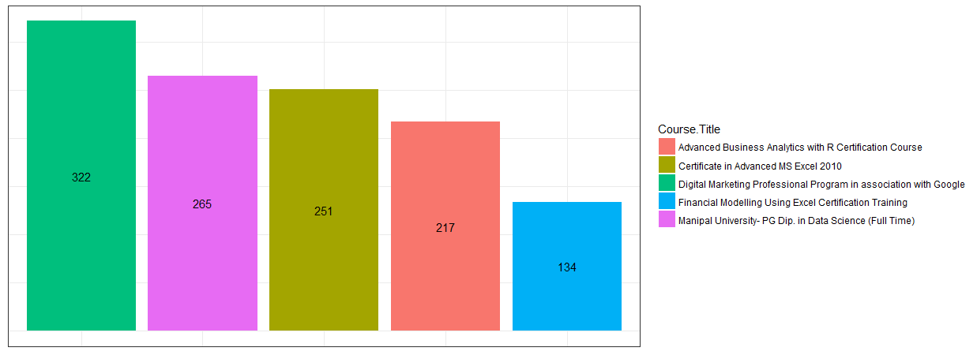
Case 2:
Which product you should focus more?
Students Onboard

Slide 5
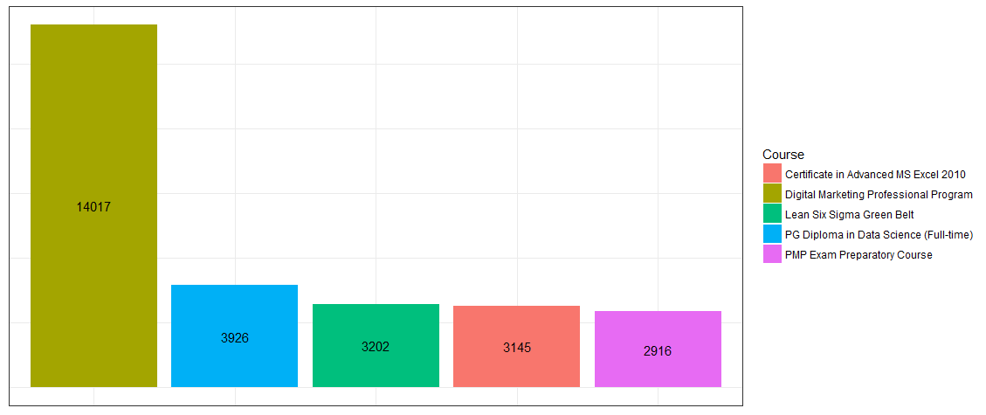
Leads Count

Slide 6
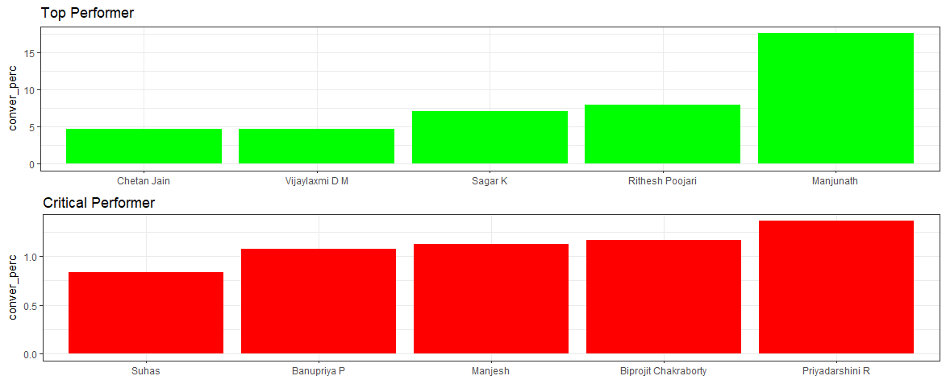
Case 3:
Your strategy for work force?
Work Force Performance

Slide 7
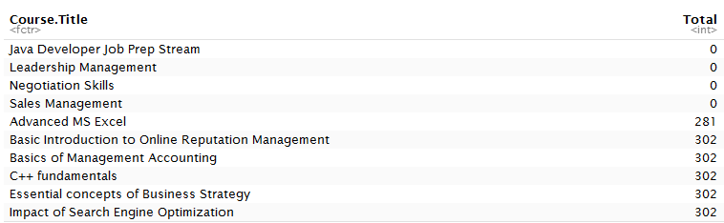
Case 4:
Strategy: 1

Slide 8
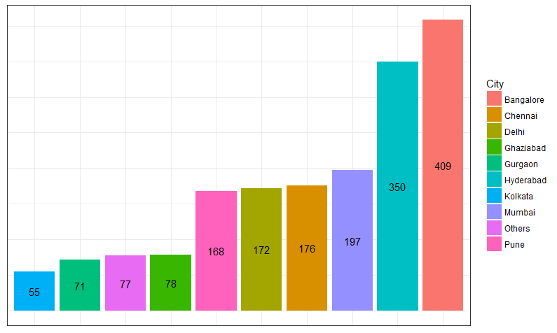
Strategy: 2
Interested / Follow up

Slide 9
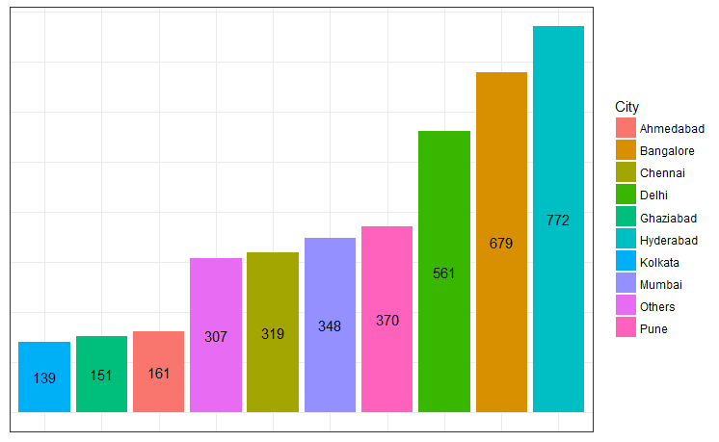
Ringing / No Response

Slide 10
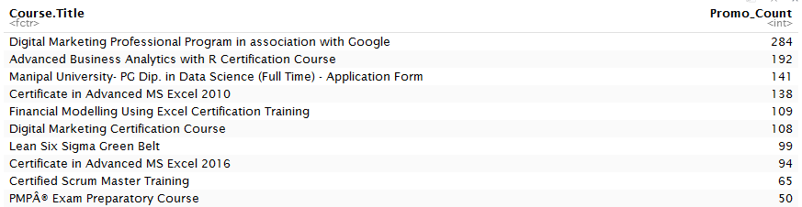
Course Wise Promo Code

Slide 11
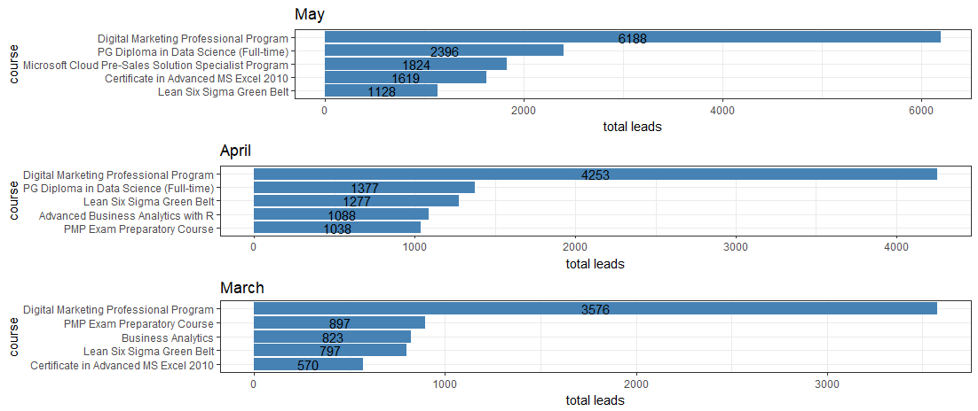
Extra Inferences

Slide 12
THANK YOU

